Slide 1


ARRAY IN C-Proggramming
Presented by:- Siburanjan Samal

Slide 2


What is an Array ?
Array is a collection of similar variables of basic datatype.
It is a group of elements having same name and are differentiated from one another by their position within the array.
Elements are stored in continuous memory location and can be accessed directly using their index only.

Slide 3

Declaration of an Array
Syntax:-
Datatype array_name[size];
Ex:-
Int arr[10];

Slide 4

Initialization of an Array
Syntax:-
Array_name[size] = {v1,v2,v3,….};
Ex:- arr[5] = {1,2,3,4,5};

Slide 5
Types of Arrays
Basically, there are three types of array :-
One Dimensional
Two Dimensional
Multi-Dimensional

Slide 6
One Dimensional Array
It is a list of the variable of similar datatypes .
It allows random access, and all the elements can be accessed with the help of their index.
The size of the array is fixed.
Representation of 1D Array is:-
Memory Locations
Elements
Index 0 1 2 3 4
100 | 104 | 108 | 112 | 116
1 | 2 | 3 | 4 | 5

Slide 7
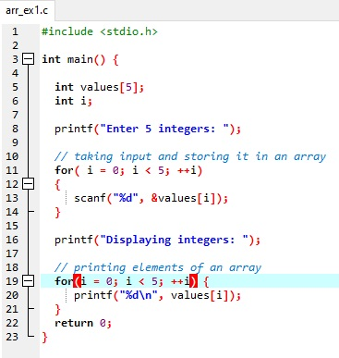
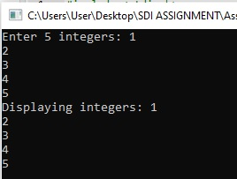
Program to store data in an array and display

Slide 8
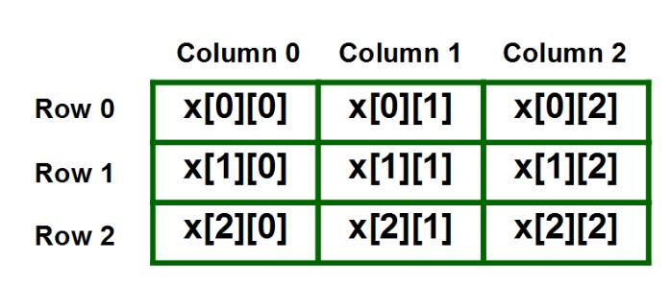
Two-Dimensional Array
It is a list of lists of the variable of the same data type.
It also allows random access, and all the elements can be accessed with the help of their index.
It can also be seen as a collection of 1D arrays. It is also known as the Matrix.

Slide 9
Declaring and Initializing 2D Array
Syntrax:-
data_type array_name[x][y];
Where x is row size and y is column size
Ex:- Declaration and initialization
int x[3][4] = {0, 1 ,2 ,3 ,4 , 5 , 6 , 7 , 8 , 9 , 10 , 11}

Slide 10
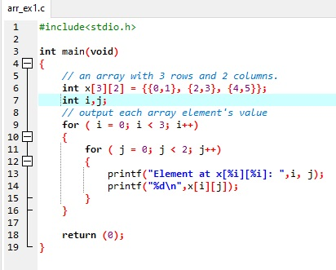
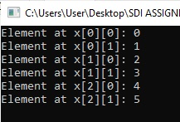
Program to store data in an 2D array and display

Slide 11
Multi-Dimensional Array
A multi-dimensional array can be termed as an array of arrays that stores homogeneous data in tabular form. Data in multidimensional arrays are stored in row-major order.
The general form of declaring N-dimensional arrays is:
data_type array_name[size1][size2]....[sizeN];
data_type: Type of data to be stored in the array.
array_name: Name of the array
size1, size2,… ,sizeN: Sizes of the dimension

Slide 12
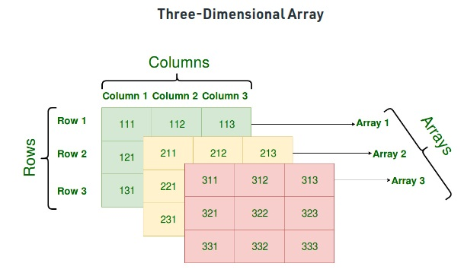
Three-dimensional array: int three_d[10][20][30]; Size of Multidimensional Arrays:
The total number of elements that can be stored in a multidimensional array can be calculated by multiplying the size of all the dimensions. For example:
Similarly array int x[5][10][20] can store total (5*10*20) = 1000 elements.

Slide 13
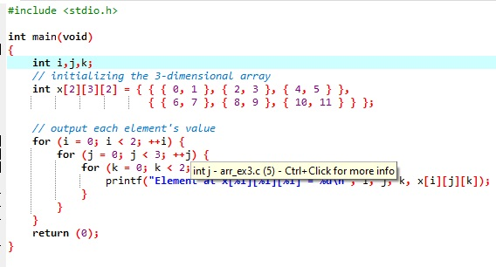
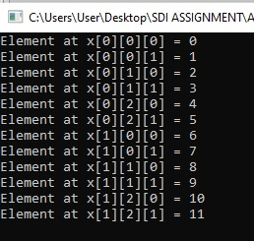
Program of 3D Array

Slide 14
Array Operations
Copying
Deleting
Insertion
Traversal
Searching
Sorting
Merging
Reversing

Slide 15
Real Life Application of Arrays
Book titles in a Library Management Systems.
Online ticket booking.
Contacts on a cell phone.
For CPU scheduling in computer.
To store the possible moves of chess on a chessboard.
To store images of a specific size on an android or laptop.

